Slide 1
HDL Part V
陳培殷
國立成功大學 資訊工程系

Slide 2
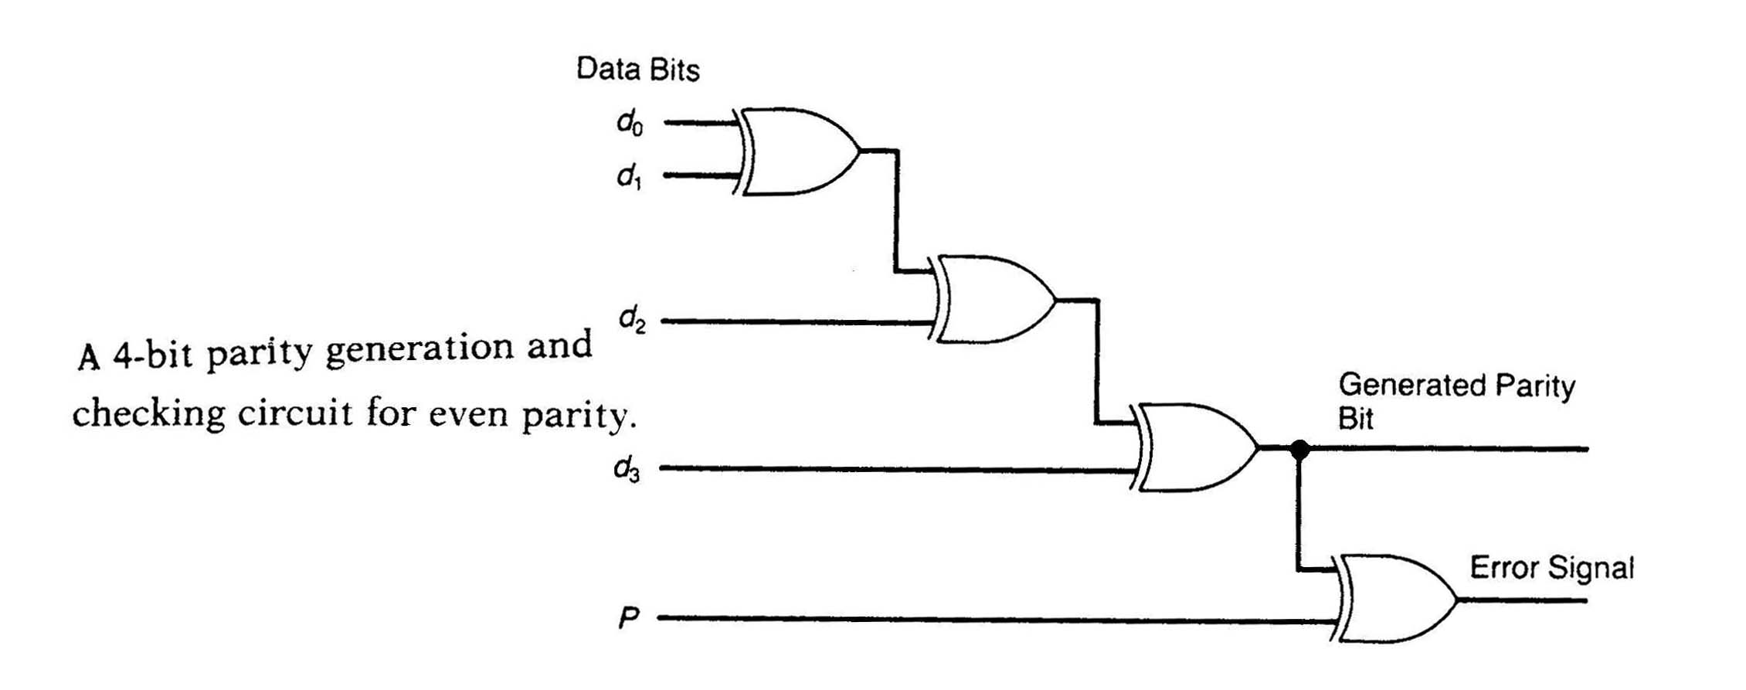
Combinational Circuit
A combinational circuit consists of logic gates whose outputs at any time are determined directly from the present combination of inputs without regard to previous inputs.
Combinational
Logic Circuit
n input
variables
m output
variables
..
..

Slide 3
Example – Alarm (1/2)
Assume that four dogs might come. Alarm is activated when (1) more than three dogs come or (2) the fourth dog come together with other dogs.
module four(A , B , C , D , Out);
input A , B , C , D;
output Out;
reg Out , temp;
always @(A or B or C or D)
begin
case({A , B , C , D})
4’b0000: Out = 0;
4’b0001: Out = 0;
4’b0010: Out = 0;
4’b0011: Out = 1;
4’b0100: Out = 0;
4’b0101: Out = 1;
A | B | C | D | Out
0 | 0 | 0 | 0 | 0
0 | 0 | 0 | 1 | 0
0 | 0 | 1 | 0 | 0
0 | 0 | 1 | 1 | 1
0 | 1 | 0 | 0 | 0
0 | 1 | 0 | 1 | 1
0 | 1 | 1 | 0 | 0
0 | 1 | 1 | 1 | 1
1 | 0 | 0 | 0 | 0
1 | 0 | 0 | 1 | 1
1 | 0 | 1 | 0 | 0
1 | 0 | 1 | 1 | 1
1 | 1 | 0 | 0 | 0
1 | 1 | 0 | 1 | 1
1 | 1 | 1 | 0 | 1
1 | 1 | 1 | 1 | 1
4’b0110: Out = 0;
4’b0111: Out = 1;
4’b1000: Out = 0;
4’b1001: Out = 1;
4’b1010: Out = 0;
4’b1011: Out = 1;
4’b1100: Out = 0;
4’b1101: Out = 1;
4’b1110: Out = 1;
default: Out = 1;
endcase
end
endmodule
Optimization is done by tools

Slide 4
Example – Alarm (2/2)
A | B | C | D | Out
0 | 0 | 0 | 0 | 0
0 | 0 | 0 | 1 | 0
0 | 0 | 1 | 0 | 0
0 | 0 | 1 | 1 | 1
0 | 1 | 0 | 0 | 0
0 | 1 | 0 | 1 | 1
0 | 1 | 1 | 0 | 0
0 | 1 | 1 | 1 | 1
1 | 0 | 0 | 0 | 0
1 | 0 | 0 | 1 | 1
1 | 0 | 1 | 0 | 0
1 | 0 | 1 | 1 | 1
1 | 1 | 0 | 0 | 0
1 | 1 | 0 | 1 | 1
1 | 1 | 1 | 0 | 1
1 | 1 | 1 | 1 | 1
module four(A , B , C , D);
input A , B , C , D;
output Out;
wire t1 , t2 , t3 , t4;
and a1(t1 , A , D);
and a2(t2 , B , D);
and a3(t3 , C , D);
and a4(t4 , A , B , C);
or o1(Out , t1 , t2 , t3 , t4);
endmodule
CD AB | 00 | 01 | 11 | 10
00 | 0 | 0 | 1 | 0
01 | 0 | 1 | 1 | 0
11 | 0 | 1 | 1 | 1
10 | 0 | 1 | 1 | 0
Out = AD + BD + CD + ABC
Traditional design method
(optimization is done by hand)
not suitable for HDL design

Slide 5
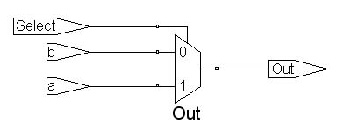
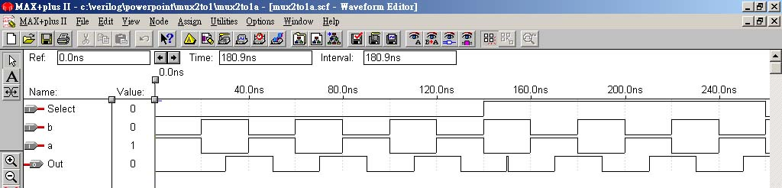
Example – Multiplexer (1/2)
multiplexer = selector
2 to 1 selector
Select | Out
1 | a
0 | b
Χ | Χ
module mux2to1a(a, b, Select, Out);
input a, b, Select;
output Out;
reg Out;
always @(a or b or Select)
begin
if (Select)
Out = a;
else
Out = b;
end
endmodule
Put all inputs of the combinational circuit into the sensitivity list, otherwise .. error

Slide 6
Example – Multiplexer (2/2)
There are three ways to derive a 2-to-1 multiplexer
always @(a or b or Select)
begin
if (Select)
Out = a;
else
Out = b;
end
always @(a or b or Select)
begin
Out=b;
if (Select)
Out = a;
end
Method_3
assign Out = Select ? a : b;
Method_1
Method_2
always @(A or B or C or D or S1 or S0)
begin
case ({S1, S0})
2'b00: Out = A;
2'b01: Out = B;
2'b10: Out = C;
default: Out = D;
endcase
end
A
B
MUX
4-to-1
multiplexer
Out
C
D
S1
S0

Slide 7
Example – Multi-Bit Multiplexer
module multibit2(a, b, Select, Out);
input [3:0] a, b;
input Select;
output [3:0] Out;
wire [3:0] Out;
assign Out = Select ? a : b;
endmodule
Actually four 1-bit 2-to-1 multiplexers are used here
module multibit2(a, b, Select, Out);
parameter width=8;
input [width-1:0] a, b;
input Select;
output [width-1:0] Out;
wire [width-1:0] Out;
assign Out = Select ? a : b;
endmodule
a
b
8
Out
8
8
1
Select
8-bit 2-to-1 multiplexer

Slide 8
Example – Encoder (4 to 2)
module encoder(A,Y);
parameter size=4;
input [size-1:0] A;
output [1:0] Y;
reg [1:0] Y;
always@(A)
begin
case(A)
4'b 0001 : Y=0;
4'b 0010 : Y=1;
4'b 0100 : Y=2;
4'b 1000 : Y=3;
default: Y=2'b00;
endcase
end
endmodule
4 to 2
encoder
inputs |  |  |  | outputs
A[3] | A[2] | A[1] | A[0] | Y[1] | Y[0]
0 | 0 | 0 | 1 | 0 | 0
0 | 0 | 1 | 0 | 0 | 1
0 | 1 | 0 | 0 | 1 | 0
1 | 0 | 0 | 0 | 1 | 1

Slide 9
Example – Priority Encoder (4 to 2)
module encoder (A,Valid,Y);
input [3:0] A;
output Valid;
output [1:0] Y;
reg Valid;
reg [1:0] Y;
always@(A)
begin
Valid=1;
casex(A)
4'b 1xxx : Y=3;
4'b 01xx : Y=2;
4'b 001x : Y=1;
4'b 0001 : Y=0;
default:
begin Valid=0; Y=2'b00; end
endcase
end
endmodule
inputs |  |  |  | outputs
A[3] | A[2] | A[1] | A[0] | Y[1] | Y[0] | Valid
0 | 0 | 0 | 0 | 0 | 0 | 0
0 | 0 | 0 | 1 | 0 | 0 | 1
0 | 0 | 1 | x | 0 | 1 | 1
0 | 1 | x | x | 1 | 0 | 1
1 | x | x | x | 1 | 1 | 1
x : don’t care

Slide 10
Example – Decoder (2 to 4)
module decoder(A,Y);
parameter size=4;
input [1:0] A;
output [size-1:0] Y;
reg [size-1:0] Y;
always@(A)
begin
case(A)
0:Y = 4'b0001;
1:Y = 4'b0010;
2:Y = 4'b0100;
default:Y = 4'b1000;
endcase
end
endmodule
2 to 4
decoder
inputs |  | outputs
A[1] | A[0] | Y[3] | Y[2] | Y[1] | Y[0]
0 | 0 | 0 | 0 | 0 | 1
0 | 1 | 0 | 0 | 1 | 0
1 | 0 | 0 | 1 | 0 | 0
1 | 1 | 1 | 0 | 0 | 0

Slide 11
Example – Decoder (3 to 6)
module decoder3_6_case1(A,En,Y);
input En; input [2:0] A;
output [5:0] Y; reg [5:0] Y;
always@(En or A)
begin
if(!En)
Y = 6'b0;
else
case(A)
0:Y = 6'b000001;
1:Y = 6'b000010;
2:Y = 6'b000100;
3:Y = 6'b001000;
4:Y = 6'b010000;
5:Y = 6'b100000;
default:Y = 6'b0;
endcase
end
endmodule
input En A2 A1 A0 | outputs Y5 Y4 Y3 Y2 Y1 Y0
0 X X X 1 0 0 0 1 0 0 1 1 0 1 0 1 0 1 1 1 1 0 0 1 1 0 1 1 1 1 0 1 1 1 1 | 0 0 0 0 0 0 0 0 0 0 0 1 0 0 0 0 1 0 0 0 0 1 0 0 0 0 1 0 0 0 0 1 0 0 0 0 1 0 0 0 0 0 0 0 0 0 0 0 0 0 0 0 0 0

Slide 12
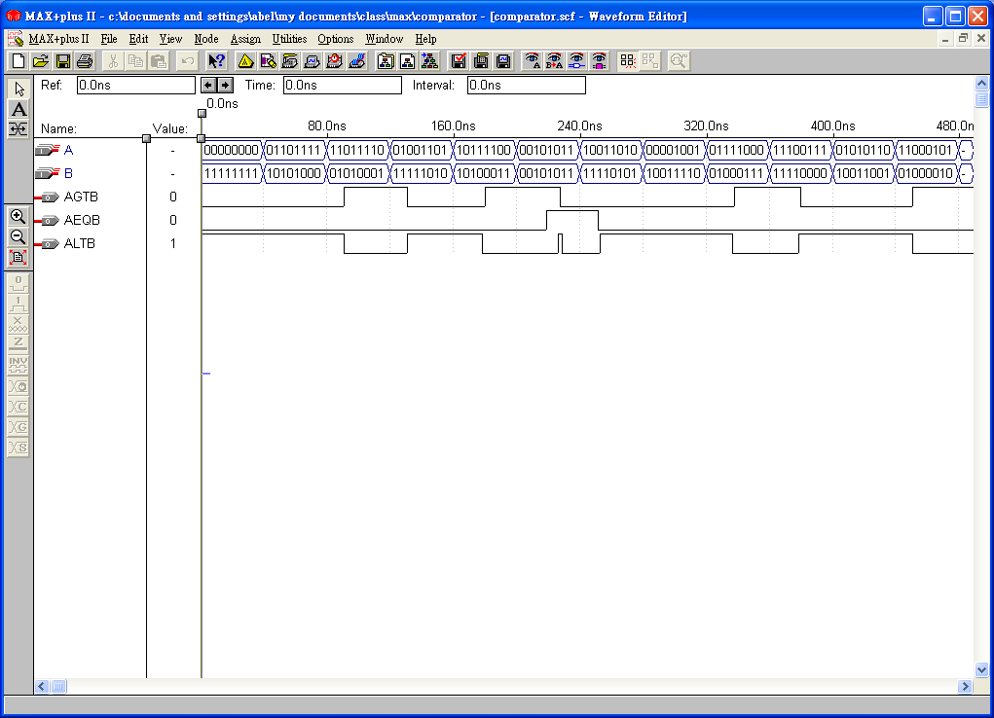
Comparator
A
B
AGTB (A>B)
AEQB (A=B)
ALTB (A<B)
Combinational comparator
comparator
module comparator(A, B, CLK, AGTB,
AEQB, ALTB);
input [7:0] A, B;
output AGTB, AEQB, ALTB;
reg AGTB, AEQB, ALTB;
always @(A or B)
begin
AGTB = (A > B);
AEQB = (A == B);
ALTB = (A < B);
end
endmodule

Slide 13
Arithmetic Logic Unit (1/2)
S4 S3 S2 S1 S0 Cin | Operation | Function | Implementation
0 0 0 0 0 0 0 0 0 0 0 1 0 0 0 0 1 0 0 0 0 0 1 1 0 0 0 1 0 0 0 0 0 1 0 1 0 0 0 1 1 0 0 0 0 1 1 1 0 0 1 0 0 0 0 0 1 0 1 0 0 0 1 1 0 0 0 0 1 1 1 0 0 0 0 0 0 0 0 1 0 0 0 0 1 0 0 0 0 0 1 1 0 0 0 0 | Y <= A Y <= A + 1 Y <= A + B Y <= A + B + 1 Y <= A + Bbar Y <= A + Bbar + 1 Y <= A - 1 Y <= A Y <= A and B Y <= A or B Y <= A xor B Y <= Abar Y <= A Y <= shl A Y <= shr A Y <= 0 | Transfer A Increment A Addition Add with carry A plus 1’s complement of B Subtraction Decrement A Transfer A AND OR XOR Complement A Transfer A Shift left A Shift right A Transfer 0’s | Arithmetic Unit Arithmetic Unit Arithmetic Unit Arithmetic Unit Arithmetic Unit Arithmetic Unit Arithmetic Unit Arithmetic Unit Arithmetic Unit Logic Unit Logic Unit Logic Unit Logic Unit Shifter Unit Shifter Unit Shifter Unit Shifter Unit

Slide 14
Arithmetic Logic Unit (2/2)
always@(Sel or A or B or CarryIn)
begin
case({Sel[4:0],CarryIn})
6'b000000 : Y = A;
6'b000001 : Y = A + 1;
6'b000010 : Y = A + B;
6'b000011 : Y = A + B + 1;
6'b000100 : Y = A + !B;
6'b000101 : Y = A + !B + 1;
6'b000110 : Y = A - 1;
6'b000111 : Y = A;
6'b001000 : Y = A & B;
6'b001010 : Y = A | B;
6'b001100 : Y = A ^ B;
6'b001110 : Y = !A;
6'b010000 : Y = A << 1;
6'b100000 : Y = A >> 1;
6'b110000 : Y = 0;
default: Y = 8'bX;
endcase
end
endmodule
module alu_case2(Sel,CarryIn,A,B,Y);
input [4:0] Sel;
input CarryIn;
input [7:0] A,B;
output [7:0] Y;
reg [7:0] Y;
A
B
8
8
ALU
Y
CarryIn
5
Sel

